Slide 1


MER2025-SEMI Challenge
More Is Better: A MoE-Based Emotion Recognition Framework with Human Preference Alignment
2nd Place Solution
Jun Xie, Yingjian Zhu, Feng Chen, Zhenghao Zhang, Xiaohui Fan, Hongzhu Yi, Xinming Wang, Chen Yu, Yue Bi, Zhaoran Zhao, Xiongjun Guan†, Zhepeng Wang†
Lenovo Research, Chinese Academy of Sciences, Beijing Jiaotong University,
Shandong University, Tsinghua University
October 2025
Notes:
Hello everyone. My name is XiongjunGuan from Tsinghua University.
Today, I’m excited to present our work titled “More Is Better: A MoE-Based Emotion Recognition Framework with Human Preference Alignment.”

Slide 2






Introduction
Multimodal Emotion Recognition (MER)
is key for empathetic Human-Computer Interaction (HCI)
Need to interpret emotions from
multiple data modalities
(vision, voice, text)
Applications span diverse domains
Smart Driving •
Healthcare •
Education
Drives more robust, human-like interactions between users and machines
Notes:
Let me start with a brief introduction to the motivation behind multimodal emotion recognition.
MER, is a key technology for building empathetic human-computer interaction systems.
To achieve this, MER systems need to interpret emotions from multiple data modalities — such as visual expressions, vocal tone, and textual content.
Each modal carries different emotional cues, and combining them helps achieve a more accurate and human-like understanding.
These techniques have wide-ranging applications.
For example, in smart driving, healthcare, and education
By integrating emotional understanding into machines, MER drives more robust and human-like interactions between users and intelligent systems.

Slide 3





Introduction
MER2025-SEMI :
7,396
labeled videos
124,802
unlabeled videos
Key Challenge :
Data limitation:
Limited scale / severely imbalanced data leads to strong overfitting / bias
Our Goal:
Develop robust, generalizable, and bias-resistant solutions
Notes:
Given the limited time, we will skip the background and related work, and concentrate on explaining our solution and the reasoning.
In the competition of MER track1, the dataset contains about 7K labeled videos and 120K unlabeled videos.
The key challenge here is data limitation.
Even though the total dataset size is large, only a small portion has ground-truth.
Moreover, the data is severely imbalanced — for example, emotions like neutral and happy are overrepresented, while worried or surprised are much rarer.
This imbalance easily causes models to overfit to frequent emotions.
Therefore, our main goal is to develop a solution that is robust, generalizable, and bias-resistant

Slide 4





Method Overview
" More is Better " Principle
Explore rich signals, distribution, and Deliberation to form a powerful integrated system
Integrate diverse input branches and independent encoders
Mixture of Experts paradigm in feature fusion (Wider > Deeper)
Constructing more high-quality data through pseudo labeling strategy
Collaborative decision-making
across multiple specialized models
Notes:
The central philosophy behind our approach is what we call the “More is Better”.
The idea is straightforward but powerful — by exploring richer signals, broader data distributions, and more collaborative deliberation,
we can form a stronger and more integrated emotion recognition system.
Our framework realizes this idea through four main strategies:
1. Integrating diverse input branches and independent encoders,
2. Using a Mixture of Experts paradigm for feature fusion.
3. Constructing high-quality data through pseudo label.
4. Encouraging collaborative decision-making across multiple models.

Slide 5







Method Overview
Three-Stage Framework
Stage 1
Stage 2
Stage 3
Embedding Extraction
Mixture of Experts
Post-Processing
Multiple parallel encoders
Modal specific experts
Multi-expert voting
Six input modalities
Router assigns importance
Rule-based re-ranking
Self-attention & FFN Projector
Weighted aggregation
Human preference alignment
Notes:
Here is an overview of our framework, which follows a three-stage pipeline.
Stage One is Embedding Extraction.
We use multiple parallel encoders to process six different modalities.
Each branch extracts its own embedding using self-attention and feed-forward projection layers.
Stage Two is the Mixture of Experts.
a router dynamically assigns importance weights to different experts, and their outputs are aggregated in a weighted manner to form a unified representation.
Finally, Stage Three is Post-Processing.
We apply multi-expert voting and rule-based re-ranking to refine the results, aligning model outputs more closely with human emotion perception.

Slide 6
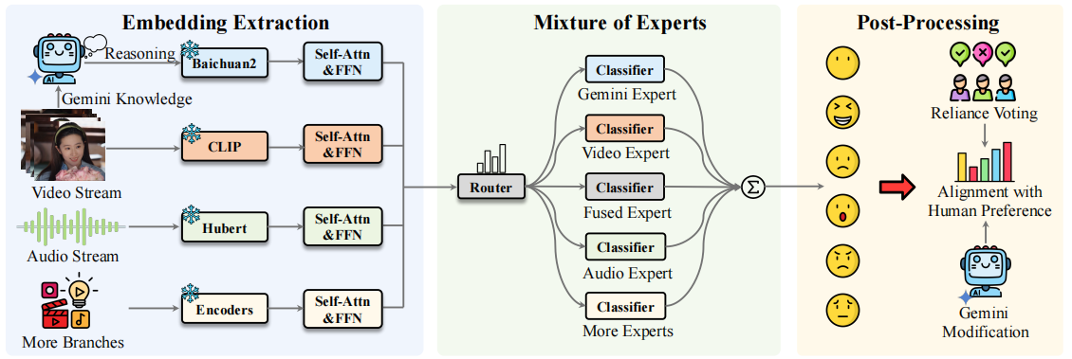
Network Architecture
Three-Stage Framework
Notes:
Here is an overview of our framework, which follows a three-stage pipeline.
Stage One is Embedding Extraction.
We use multiple parallel encoders to process six different modalities.
Each branch extracts its own embedding using self-attention and feed-forward projection layers.
Stage Two is the Mixture of Experts.
a router dynamically assigns importance weights to different experts, and their outputs are aggregated in a weighted manner to form a unified representation.
Finally, Stage Three is Post-Processing.
We apply multi-expert voting and rule-based re-ranking to refine the results, aligning model outputs more closely with human emotion perception.

Slide 7






More Signals: Broader Perspective
Full-Frame Images
Audio Stream
Caption Text
Complete video frames with background context and environmental cues
Vocal features including pitch, tone, speech rate, and volume
Lexical content and semantic information from speech transcripts
NOVEL SIGNAL
NOVEL SIGNAL
NOVEL SIGNAL
Cropped Face Images
Temporal AU Analysis
Gemini Knowledge
Isolated facial features at multiple resolutions for detailed expression analysis
Sequential Action Unit dynamics capturing fine-grained facial movements
VLM-powered reasoning with multi-modal analysis and confidence scores
Notes:
Now, let us focus on the idea of “More Signals”.
Conventional emotion recognition relies mainly on video frames, audio, or captions, yet emotions manifest through many additional cues.
Moreover, since our base encoders are pretrained and frozen, they may miss task-specific information.
To address this, our framework incorporates three additional input branches: facial regions, temporal AU analysis, and Gemini knowledge.

Slide 8


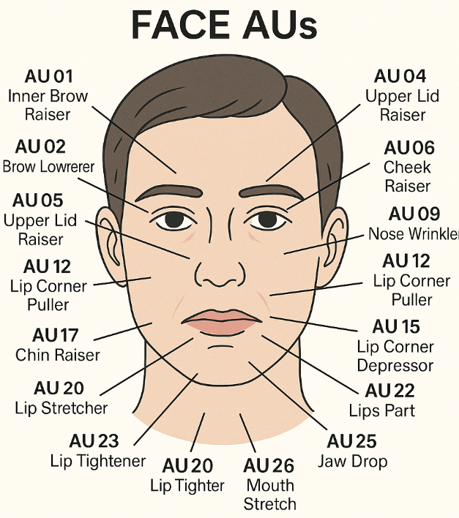

Novel Signal : Temporal AU Analysis
Why Temporal AU?
Traditional approaches: Frame-level visual features , Froszen encoder
Problem:
Overlooks critical temporal dynamics in emotion recognition
Solution:
Explicit temporal modeling of Action Unit variations
Technical Pipeline
B × T × 35
Each frame encoded as 35-dimensional AU vector by OpenFace
B × T × d
Linear projection to d-dimensional feature space
B × (T+1) × d
Prepend learnable [CLS] token
Self-Attn + FFN
Temporal aggregation via transformer
[CLS] Feature
Final temporal AU representation
Notes:
Here we introduce Temporal AU Analysis.
As previously mentioned, traditional visual approaches usually rely on frame-level features extracted by a frozen pretrained encoder.
However, such models often overlook important temporal dynamics , which is crucial for emotion recognition.
To address this, we specifically capture the temporal variations of facial Action Units.
Each video frame is first encoded as a 35-dimensional AU vector using OpenFace.
We then project these vectors into a d-dimensional feature space, add a learnable [CLS] token,
and use a Transformer to aggregate information across frames through self-attention.
Finally, we take the class token as the embedded representation

Slide 9









Novel Signal : Gemini Knowledge Integration
Raw Video
Gemini-2.5-Flash
JSON Output
Baichuan2-7B
with Audio
Vision-Language Model
Structured Analysis
Text Encoder
Reasoning Process
Confidence Scores
Detailed emotion analysis based on facial AUs, body posture, head pose, inter-frame relationships, and audio features
Confidence levels for 6 emotions: neutral, angry, happy, sad, worried, surprised
Final Label
Modality Contribution
Predicted emotion category for easier data processing and downstream tasks
Dynamic weighting of modality cues based on context-specific importance
Notes:
Next, we introduce another novel signal — Gemini Knowledge Integration.
Here, we use Gemini-2.5-Flash, a large vision-language model, to perform detailed reasoning on each raw input.
Gemini analyzes original videos, and then produces a structured JSON output.
This output contains four key parts:
1. a reasoning process, which describes the process of perception and reasoning,
2. confidence scores for six emotion categories,
3. a final predicted label
4. modality contribution weights
We then feed this structured text into text encoder, which converts Gemini’s reasoning into an embedding that becomes another “expert” in our system.

Slide 10

Novel Signal : Gemini Knowledge Integration
Raw Video
Gemini-2.5-Flash
JSON Output
Baichuan2-7B
with Audio
Vision-Language Model
Structured Analysis
Text Encoder
Output structured
JSON format
containing:
:
"REASON"
"Detailed emotion analysis..."
"SCORES"
:
{neutral: 0.8, angry:0.0, happy:0.1, sad:0.1, worried:0.0, surprised:0.0}
"LABEL"
:
"neutral"
:
"CONTRIBUTION
{visual: 0.5, audio: 0.4, text: 0.1}
Xie J, Guan X, Zhu Y, et al. Four Eyes Are Better Than Two: Harnessing the Collaborative Potential of Large Models via Differentiated Thinking and Complementary Ensembles[J]. arXiv preprint arXiv:2505.16784, 2025.
Notes:
This is an example of JSON output, demonstrating the result format of gemini
We referred to our previous work on the selection and order of key elements in this Chain of Thoughts

Slide 11






More Samples, Fuller Distribution
Common Pseudo-Labeling
Our Solution
×
Self-reinforcing loop on one model
✓
Baseline + Gemini consensus
×
Knowledge closure
✓
Majority voting increases the quality of screening
×
Difficult to determine appropriate filtering threshold
✓
Break the bias loop
Two-Stage Training Paradigm
Unlabeled Data
Stage 1: Pretraining
Stage 2: Fine-tuning
124,802 samples
Consensus pseudo-labels (20,000)
Labeled data (7,396)
Notes:
Next, let’s talk about how we make better use of unlabeled videos.
Traditional pseudo-labeling usually depends on a single model to generate labels. But that often leads to a feedback loop with its own biases.
And It’s also tricky to set a good confidence threshold.
To overcome this, we combine predictions from our baseline and Gemini, and take the majority vote. This way, we get higher-quality pseudo-labels and avoid bias accumulation.
As shown here, our training has two stages:
First, we pretrain the model with about 20K pseudo-labeled samples.
Then, we fine-tune it with all 7K labeled samples.

Slide 12



More Deliberation, Less Bias
Reliability-based Weighted Voting
Improve stability and generalization through model ensemble
r
= Σ I(y
= ŷ
) / n → ŷ = argmax
Σ r
· p
e
i
e,i
k
e
e,k
Quantitative Evaluation
Analyzing the complementarity and redundancy of models
Accuracy
Repetitiveness
Confusion matrix
Rule-based Re-ranking for Neutral Bias
Align the results with human preferences
If top vote = 'neutral' & 2nd = 'angry' → modify to 'angry'
If top vote = 'neutral' & 2nd vote exceeds 25% → use 2nd emotion
If VLM predicts 'angry', 'happy', or 'surprise' → trust VLM judgment
Notes:
Finally, we focus on how our system performs multi-expert deliberation to reduce bias and improve stability.
We adopt a reliability-based weighted voting scheme, In this way, the ensemble becomes more stable and generalizable.
We also analyze model complementarity using metrics like accuracy, repetitiveness and confusion matrices to confirm that different models bring unique insights.
Finally, a rule-based re-ranking step helps correct neutral bias.

Slide 13
More Deliberation, Less Bias
Emotion Distribution Comparison
Strategy
Neutral
Angry
Happy
Sad
Worried
Surprised
Ground Truth (Val)
24.8%
24.0%
20.6%
14.5%
12.2%
3.8%
Single Model
48.4%
14.2%
10.2%
13.3%
11.0%
2.9%
After Voting
49.2%
14.9%
10.7%
13.6%
8.8%
2.9%
After Re-ranking
41.6%
18.7%
11.5%
15.6%
9.7%
3.0%
Notes:
This slide shows a comparison of emotion distributions under different prediction strategies.
In our validation set, we can see that neutral emotions account for about 25%, .
However, when using a single model, the predictions become strongly biased — the neutral class rises to almost 48%, while the proportion of angry and happy drops significantly. This demonstrates the neutral bias problem caused by data imbalance and model overconfidence.
After applying our ensemble voting, the imbalance remains.
And finally, after our rule-based re-ranking, the neutral proportion decreases to around 41%, bringing the overall distribution much closer to the ground truth.

Slide 14


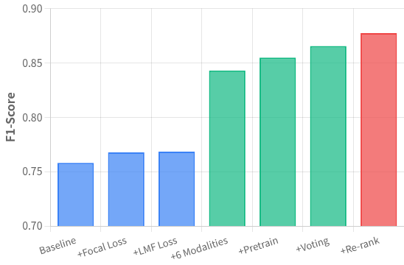

Experiments
Dataset Details
Ablation Study Results
Train & Val:
7,396 labeled videos
Unlabeled:
124,802 (20,000) videos
Final Test:
20,000 videos
Strategy:
5-fold cross-validation with equal weighting
Key Configurations
Learning rate: 1e-3 → 1e-4 (cosine annealing)
Batch size: 256, AdamW optimizer
Training: ~10 epochs until convergence
Final ensemble: 15 distinct models
Notes:
This slide summarizes our experimental setup and results.
On the right, you can see the ablation study results.
Starting from the baseline, we gradually add key components —
first focal loss and LMF loss, then six modalities, pretraining, voting, and re-ranking.
It can be seen that every part of our framework contributes meaningfully to the overall gain.

Slide 15

Experiments
Single Modal Benchmark Comparison
Visual Modality
Audio Modality
Text Modality
Method
F1-Score
Method
F1-Score
Method
F1-Score
CLIP-ViT
0.67
CHN-HuBERT
0.75
Baichuan2
0.56
InternVL
0.62
Qwen2-Audio
0.68
BLOOM
0.53
DINO V2
0.59
CHN-Wav2Vec2
0.67
CHN-RoBERTa
0.53
A stronger global generalization capability is more advantageous
Pre-training aligned with the target field is highly important
Difference in text modality is not significant
Notes:
Here we present the single-modal benchmark comparison results.
For the visual modal, we tested several backbones.
Among them, CLIP achieved the best score, showing that models with stronger global generalization capability perform better in this task.
For the audio modal, CHN-HuBERT clearly outperforms the others, which highlights the importance of pretraining that is aligned with the target field.
For the text modal, the differences are relatively small.
This indicates that text features alone are less discriminative for emotion prediction in this dataset.

Slide 16
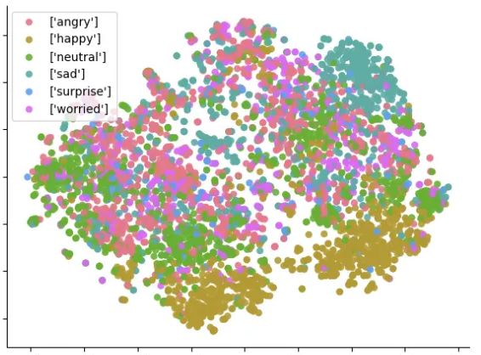
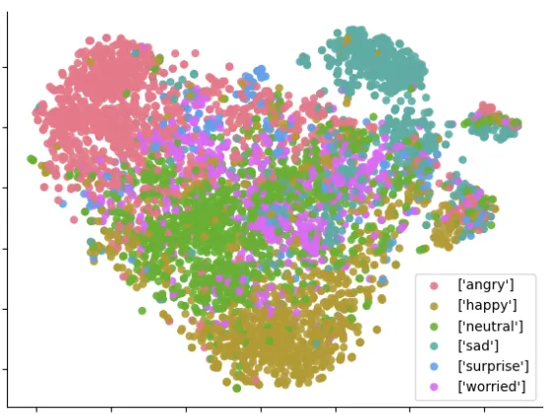
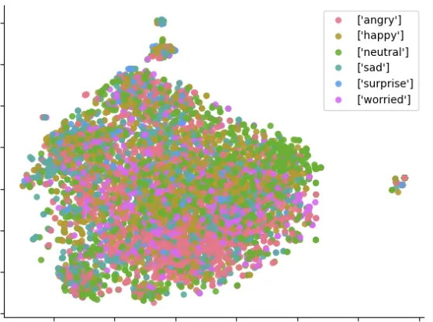



Experiments
Feature Visualization
Visual
Audio
Text
F1 Score: 0.67
F1 Score: 0.75
F1 Score: 0.56
Notes:
We also visualized features from these three modals.
Each point here represents a 2D embedding of the video sample , and colors indicate different emotion categories.
As you can see, the audio modality (in the middle) provides the clearest separation between emotions,
The visual modality (on the left) also shows some structure — some clusters are distinguishable, but there’s still overlap,
However, the text modality (on the right) exhibits strong overlap among different classes, indicating that text alone carries limited emotional discrimination,

Slide 17




Conclusion
0.8772
2nd Place
F1-Score
MER2025-SEMI Track
Open-source Repository
https://github.com/zhuyjan/MER2025-MRAC25
Future Directions
→
Explore additional modalities and expert architectures to further enhance MoE performance
→
Improve generalization capabilities across diverse datasets and emotion taxonomies
→
Investigate real-time deployment strategies for practical HCI applications
Discuss with Me
gxj21@mails.tsinghua.edu.cn
Notes:
To conclude, our proposed multi-modal emotion recognition framework achieved an F1-score of 0.8772,
which ranked second place in MER Track 1.
Our code is open-sourced on GitHub, and we welcome you to follow our work.
Looking ahead, we aim to push our framework further —by adding more modalities, refining expert designs, improving generalization across datasets,and ultimately enabling real-time, human-centered interaction.
Thank you all for listening. you can reach me by this email, I’d love to continue the discussion or answer any questions you may have .

