Slide 1






Zhepeng Wang*, Xiaohui Fan*, et al.
MRAC '25, October 27–31, 2025 Dublin, Ireland
Notes:
Good morning everyone. My name is Yixuan Fan, and today I’ll present our work titled JPDS-NN: Reinforcement Learning-Based Dynamic Task Allocation for Agricultural Vehicle Routing Optimization.

Slide 2
①
Background & Introduction
Problem statement, motivation, and key challenges
②
Methodology
Presentation
Overview
ZeroES framework architecture, model selection, and prompt engineering
③
Experiments & Results
Performance evaluation, comparative analysis, and ablation studies
④
Conclusion & Future Work
Key contributions, limitations, and research directions
Notes:
Good morning everyone. My name is Yixuan Fan, and today I’ll present our work titled JPDS-NN: Reinforcement Learning-Based Dynamic Task Allocation for Agricultural Vehicle Routing Optimization.

Slide 3






Challenge of Emotion Recognition
Closed-Set Limitation
Conventional approaches assume predefined taxonomies, failing against the vast, evolving spectrum of emotional expression
Every emotion must be known a priori
Subjectivity & Diversity
Human emotions exhibit high subjectivity, influenced by cultural, contextual, and individual factors
Cross-cultural and contextual variations
Open-Vocabulary Demand
Real-world scenarios require models that can name emotions freely across variable granularities
Unconstrained semantic space
Notes:
Autonomous farming systems are transforming agriculture, but they still face challenges in coordination and task planning. Efficient algorithms are needed to manage complex and dynamic field operations. As shown in the images, large-scale farms in northeastern China involve cooperative operations of multiple agricultural machines, which require intelligent planning to optimize performance.

Slide 4




Critical Limitations of Existing VLLM Solutions
Over-reliance on Fine-tuning
Marginal gains with compromised scalability
Task-specific adaptation limits generalization
Amplifies bias and collapses coverage
Inadequate Zero-shot Exploitation
Underutilized large-scale VLM potential
Complex video-based recognition challenges
Limited cross-modal understanding
Neglected Complementary Synergies
Generic VLM + domain-specific priors
Prompt engineering limitations
Specialized fine-tuning constraints
Notes:
Autonomous farming systems are transforming agriculture, but they still face challenges in coordination and task planning. Efficient algorithms are needed to manage complex and dynamic field operations. As shown in the images, large-scale farms in northeastern China involve cooperative operations of multiple agricultural machines, which require intelligent planning to optimize performance.

Slide 5
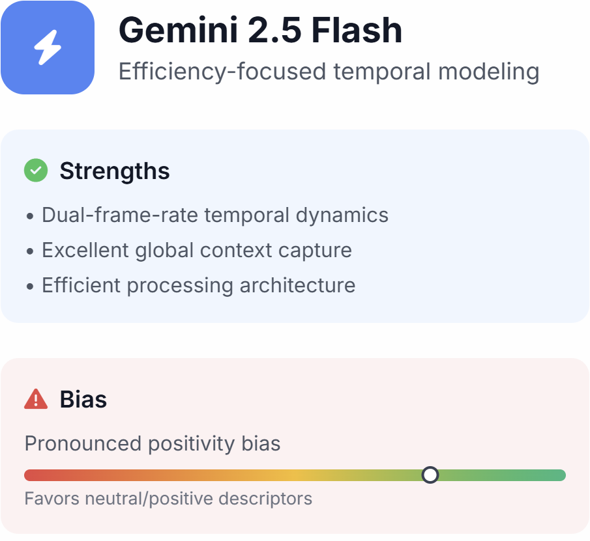
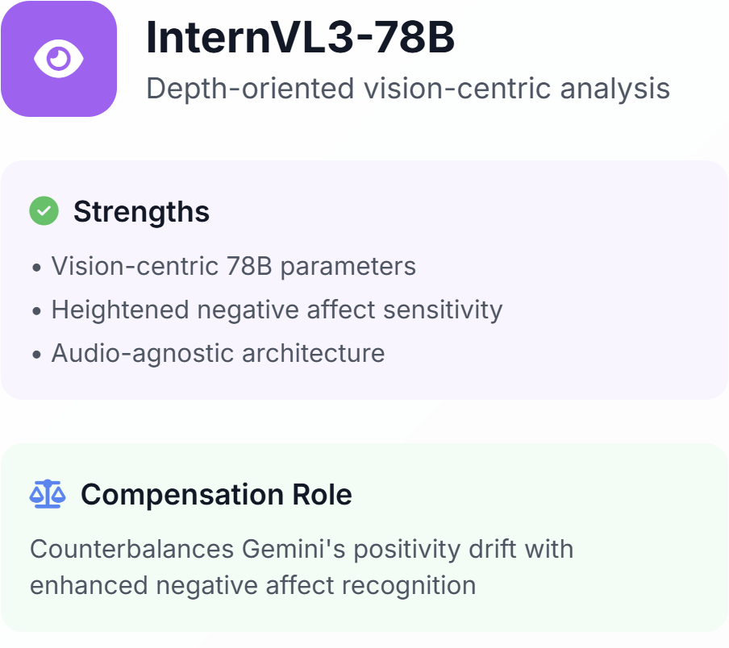
Strategic Model Selection
Complementary strengths through deliberate bias compensation and architectural diversity

Slide 6
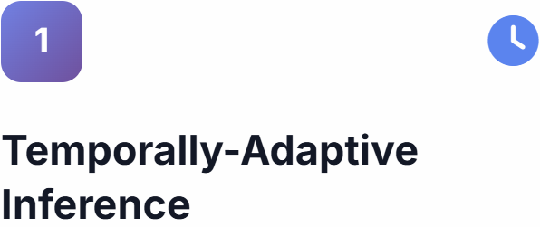
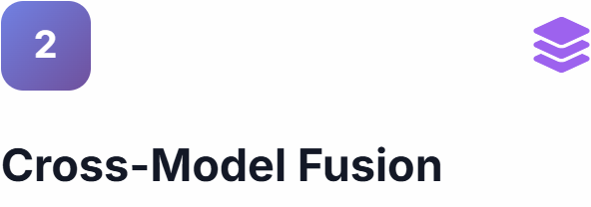
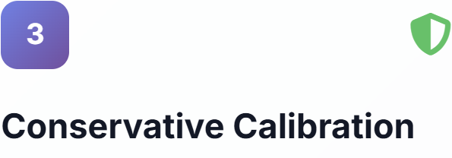
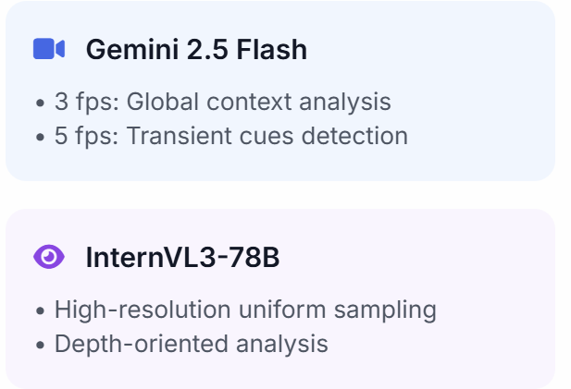
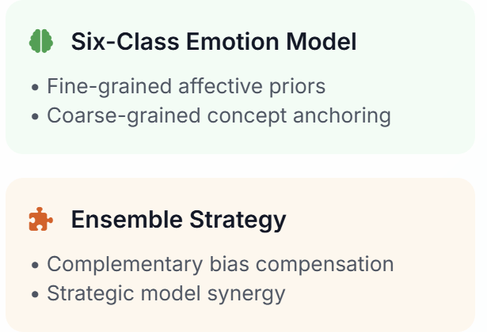
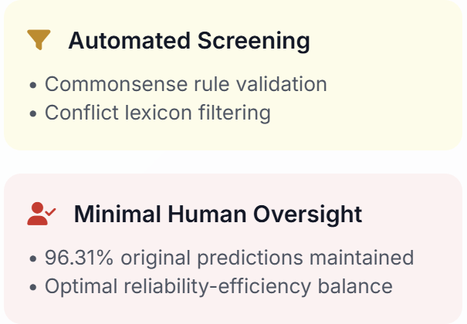
ZeroES Framework

Slide 7
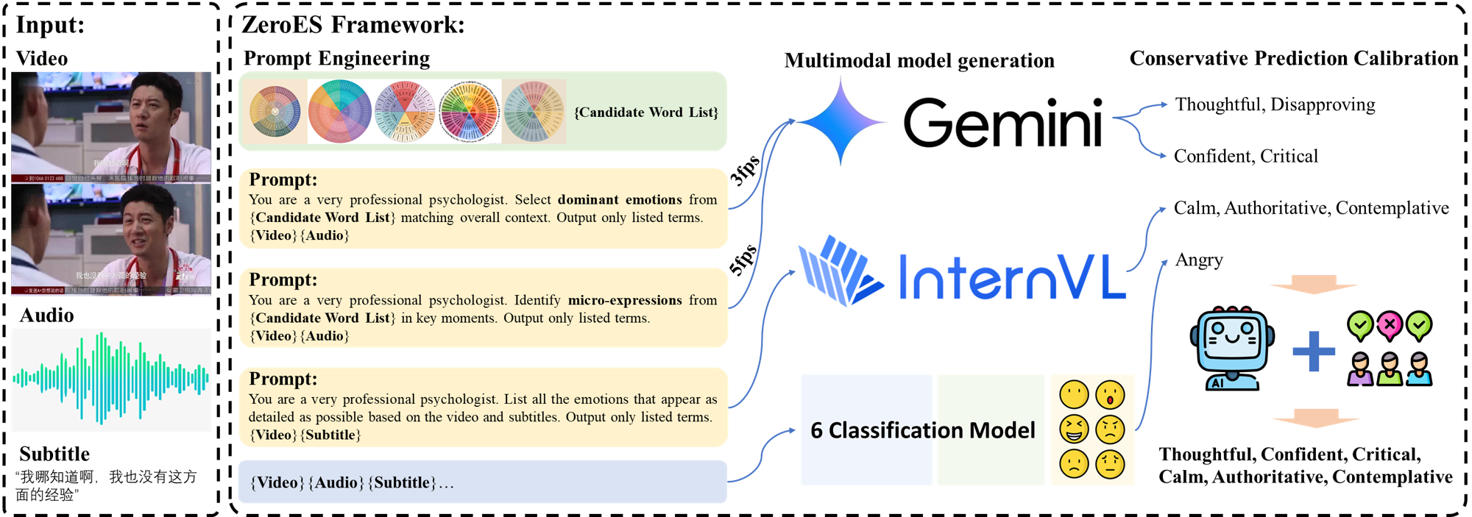

ZeroES Framework
Notes:
Autonomous farming systems are transforming agriculture, but they still face challenges in coordination and task planning. Efficient algorithms are needed to manage complex and dynamic field operations. As shown in the images, large-scale farms in northeastern China involve cooperative operations of multiple agricultural machines, which require intelligent planning to optimize performance.

Slide 8
Prompt Template
Confidence-based Screening Module (using Gemini)
Gemini2.5 Flash 3fps
Gemini2.5 Flash 5fps
InternVL3-78B
## Task
You are a very professional psychologist. I will provide you with a video. You need to analyze the emotions of the characters in the video and finally extract the emotional labels. Emotional descriptions and reasoning should be enclosed in tags, <think> and </think>. emotional labels should be enclosed in tags <answer> and </answer> in the form of a list. If more than one person appears in the video, only the emotions of the main character need to be analyzed.
## Instruction
Focus on the overall coarse-grained context of the video, including general tone, content, and macro-level emotional arcs. Pay attention to broad emotional states rather than transient micro-expressions. Analyze and give reasoning processes from multiple aspects, and finally form emotional labels. There are the following emotion labels for your reference. Alternative and potentially more appropriate emotional labels may also be generated. The video duration is {duration} seconds.
## Candidate Emotional labels
{emotion_candidates}
## Output Format
<think>Your reasoning </think> <answer> [emotional label1, emotional label2] </answer>
## Output:
## Task
You are a very professional psychologist. I will provide you with a video. You need to analyze the emotions of the characters in the video and finally extract the emotional labels. Emotional descriptions and reasoning should be enclosed in tags, <think> and </think>. emotional labels should be enclosed in tags <answer> and </answer> in the form of a list. If more than one person appears in the video, only the emotions of the main character need to be analyzed.
## Instruction
Focus on fine-grained details such as micro-expressions (AU units), transient emotional changes, and subtle tone variations in the video. Emphasize momentary and nuanced emotions rather than broad contexts. Analyze and give reasoning processes from multiple aspects, and finally form emotional labels. There are the following emotion labels for your reference. Alternative and potentially more appropriate emotional labels may also be generated. The video duration is {duration} seconds.
## Candidate
Emotional labels{emotion_candidates}
## Output
Format:<think>Your reasoning </think> <answer> [emotional label1, emotional label2] </answer>
## Output:
## Task
You are a very professional psychologist. I will provide you with a video and it's subtitles. You need to extract corresponding emotional labels from it.
## Instruction
You need to pay attention to the content, tone and micro-expressions of the characters in the video (AU unit), analyze and give reasoning processes from multiple aspects, and finally form emotional labels. The final emotional labels should select one or more of the following candidate emotional labels.
## Candidate Emotional labels
{emotion_candidates}
## Output Format
[emotional label1, emotional label2]
## Output:
## Task
Check the following emotional vocabulary to determine if there are any words whose meaning or emotion is opposite to other words, and provide corresponding reasons and confidence scores (0-10 points) If the conclusion is that there is no significant contrast, score below 5 points If the conclusion is that there is a significant contrast, the score should be above 5 points, and the more obvious, the higher the score Please place your reasoning process in the <think> tag and the score in the <answer> tag. The <answer> tag must contain only one integer
## Emotional vocabulary
{emotion_candidates}
## Output format
<think> Your reasoning process </think> <answer> Score (integer 1-10) </answer>
## Output:
Notes:
Autonomous farming systems are transforming agriculture, but they still face challenges in coordination and task planning. Efficient algorithms are needed to manage complex and dynamic field operations. As shown in the images, large-scale farms in northeastern China involve cooperative operations of multiple agricultural machines, which require intelligent planning to optimize performance.

Slide 9
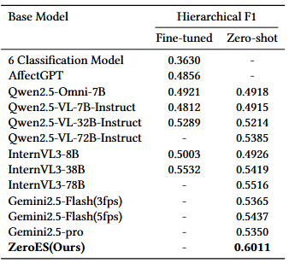


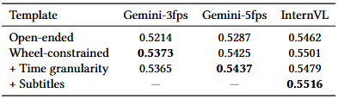

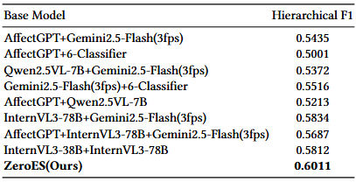

Critical Component Analysis
Gemini Dual-Frame
Role: 3fps context + 5fps transient cues
Impact: Temporal granularity bridging enhanced
InternVL 78B
Role: Counterbalance positivity bias
Impact: Negative affect recognition enhanced
Six-Class Model
Role: Foundational anchoring function
Impact: Coarse-grained accuracy assured
Calibration
Role: Commonsense filtering & human oversight
Impact: Eliminates absolute contradictions
Notes:
The core problem is how to allocate tasks to agricultural vehicles efficiently. Traditionally, we model this problem as Vehicle Routing Problem, or VRP, and using methods include exact solutions, heuristics, and neural networks to solve it. However, they often struggle with task granularity, computational efficiency, and generation of optimal training samples. Our work addresses these limitations.

Slide 10
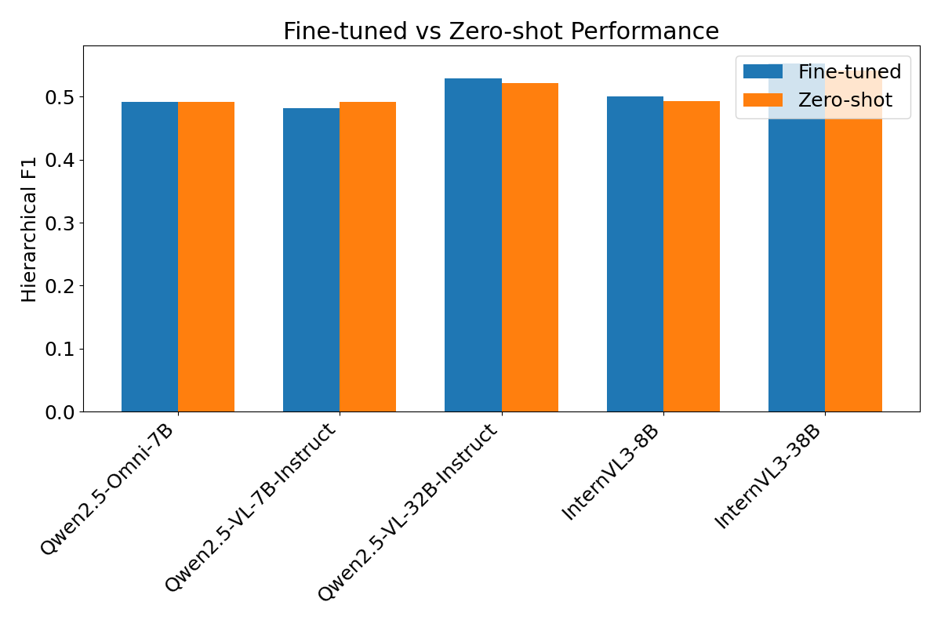


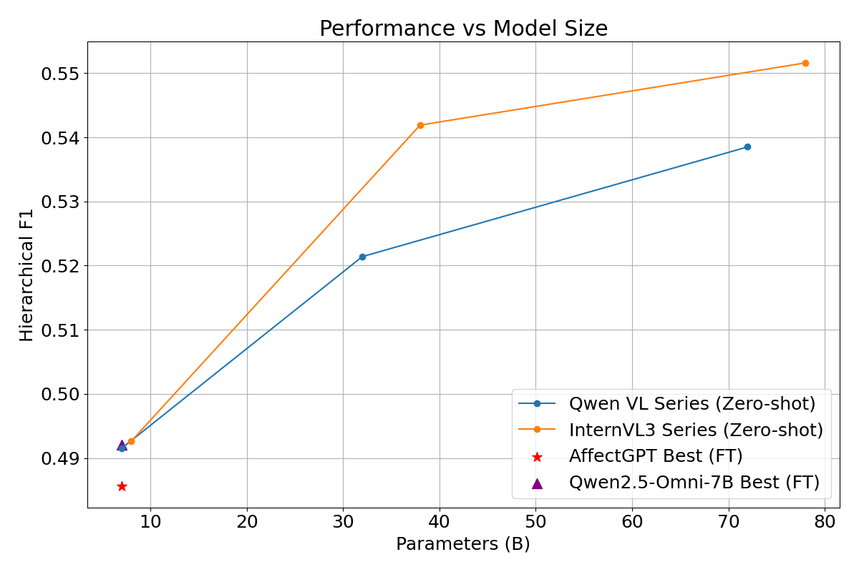

Key Research Insights
Fine-tuning Paradox
Discovery: Task-specific adaptation constrains output diversity and amplifies distributional sensitivity
Temporal-Granular Decoupling
Innovation: Dual-frame architecture achieves hierarchical alignment throught emporal-stratified sampling
Affective Polarity Synthesis
Strategy: Strategic bias compensation between Gemini's positivity and InternVL's negative sensitivity
Notes:
The core problem is how to allocate tasks to agricultural vehicles efficiently. Traditionally, we model this problem as Vehicle Routing Problem, or VRP, and using methods include exact solutions, heuristics, and neural networks to solve it. However, they often struggle with task granularity, computational efficiency, and generation of optimal training samples. Our work addresses these limitations.

Slide 11





Future Directions
Current Limitations
Research Directions
Dynamic Temporal Adaptation
Auto-adjust frame rates based on affective intensity scores
Context-Dependent Emotions
Misinterpretation of emotions that
heavily depend on situational context
Cross-Cultural Knowledge Infusion
Geographically stratified affective lexicons for cultural diversity
Micro-Expression Detection
Misinterpretation of emotions that
heavily depend on situational context
Causal Intervention Modules
Disentangle scene-confounder relationships for robust inference
Notes:
The core problem is how to allocate tasks to agricultural vehicles efficiently. Traditionally, we model this problem as Vehicle Routing Problem, or VRP, and using methods include exact solutions, heuristics, and neural networks to solve it. However, they often struggle with task granularity, computational efficiency, and generation of optimal training samples. Our work addresses these limitations.

Slide 12
Thank You for Your Attention!
fxh23@mails.tsinghua.edu.cn
Notes:
Thank You for Your Attention! If you have any questions, you can contact me by email or browse our project website

